Slide 1


THE MIKE mims Foundation
Disaster Relief and Humanitarian Aid Packages and Products
2013
130 Corridor Rd #992 1411 H Street NE
Ponte Vedra Beach, Florida, 32004 Washington, DC 20002
Jackie Mims,CEO/Founder (202)864-6612
President Mike Mims
Advisors: Ret. 4 star General Lloyd Newton
Ret. Colonel Donald Newton
Notes:
Supporting and Making A Difference For Those In Need.

Slide 2
The mike mims foundation INCORPORATED
Mission and Vision
Our mission is to secure, package and maintain critical items, as a resource for both governmental and non governmental entities whose mission is to abate suffering when disaster strikes. Ultimately we strive to, with immediacy, provide essential comforts to those in need.
We aim to become the international leader in supplying disaster relief and humanitarian aid packages.
Notes:
Catering To Those In Need.

Slide 3
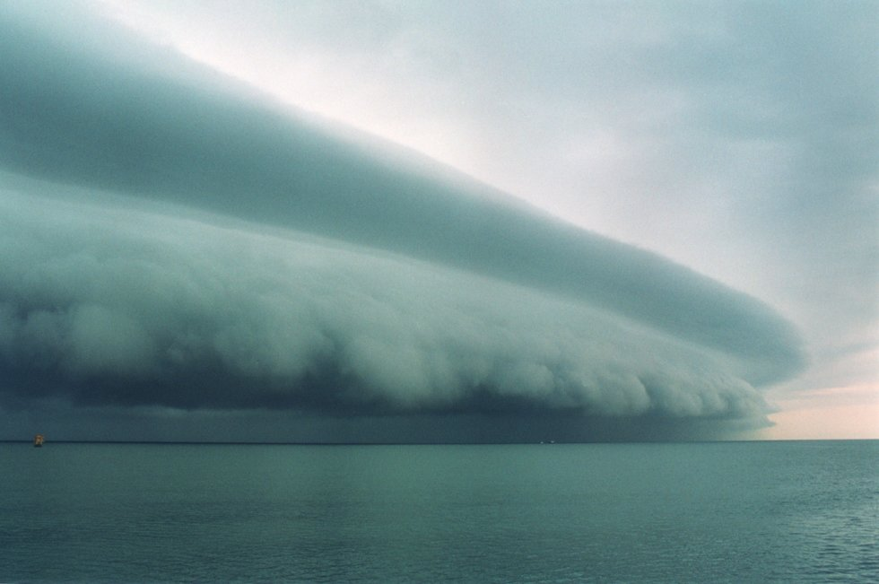
THE MIKE MIMS FOUNDATION INCORPORATED
DISASTER RELIEF AND HUMANITARIAN AID
Notes:
Disasters happens unexpected- Be Prepared

Slide 4
THE MIKE MIMS FOUNDATION INCORPORATED
How we can help
Provide quality care packages at a great price
  Customizable packages to fit any demographic (e.g. gender, age)
  Custom branding including messaging and logos on care packs and specific products available upon request
Quality people & service throughout supply chain
  Extensive network of reliable manufacturers to deliver goods on time
  Additional services available for relief package storage and disaster deployment
Notes:
Supporting those in need.

Slide 5



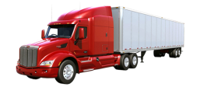
THE MIKE MIMS FOUNDATION INCORPORATED
DISASTER RELIEF AND HUMANITARIAN AID
LOGISTICS TRANSPORTATION
Notes:
Trucking, Railways, Aircrafts and Postal Mail.
Trucking, Railways, Aircrafts, Fed-Ex, UPS, and Postal Mail

Slide 6
The mike mims foundation INCORPORATED
The CARE packs available
Care packs are completely customizable based on the needs of your organization. In addition, we offer five types of bundled packages:
Family Pack
Unisex Pack
Female Pack
Male Pack
Child/Baby Pack
Each package types’ product details available upon request.
Notes:
Designed for Hospital, Shelters, Armed Forces, etc.

Slide 7
THE MIKE MIMS FOUNDATION INCORPORATED
DISASTER RELIEF AND HUMANITARIAN AID
Our kits are designed to meet most of the immediate needs of disaster victims by providing comfort in the moment of crisis. We strive to offer a budget friendly solution for creating Disaster Preparedness Kits and can assist you in meeting your objectives by:
being your primary resource to create a disaster readiness kits
supplementing your primary source to increase inventory
serving as your contingency plan to provide you with Disaster Preparedness Kits.

Slide 8

The mike mims foundation INCORPORATED
ASSORTED CARE packs ARE available
Notes:
Assorted Hygiene Care Package To Meet Your Need

Slide 9
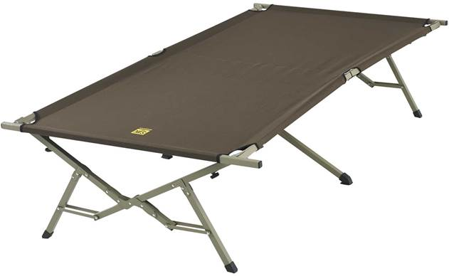
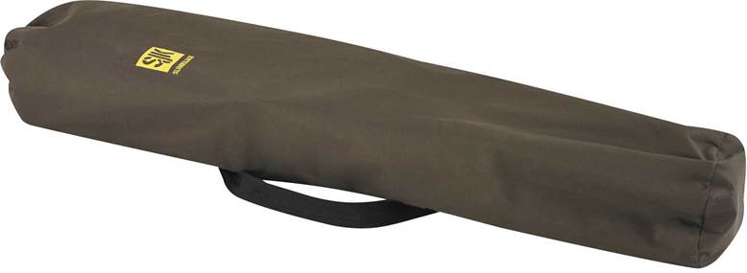
THE MIKE MIMS FOUNDATION INCORPORATED
DISASTER RELIEF AND HUMANITARIAN AID
MP067 SLUMBERJACK BIG COT
Notes:
Weight Capacity: 500 lbs Dimensions: 40 x 86 x 20 in Fabric: 600D Polyester

Slide 10
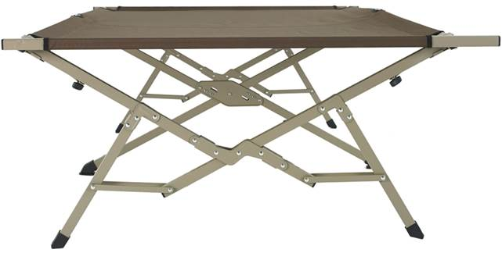
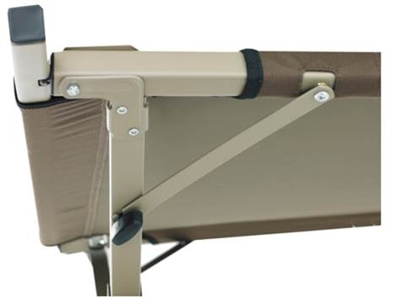
THE MIKE MIMS FOUNDATION INCORPORATED
DISASTER RELIEF AND HUMANITARIAN AID
MP067 SLUMBERJACK BIG COT
Notes:
Weight Capacity: 500 lbs Dimensions: 40 x 86 x 20 in Fabric: 600D Polyester

Slide 11

THE MIKE MIMS FOUNDATION INCORPORATED
Ready-To-Eat-Meals & Supplies For Emergencies
Notes:
SV021 Wise Emergency Food Pepper Pack

Slide 12

THE MIKE MIMS FOUNDATION INCORPORATED
Ready-To-Eat-Meals & Supplies For Emergencies
Notes:
SV022 Wise Ultimate 72-Hour Meals

Slide 13


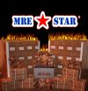




THE MIKE MIMS FOUNDATION INCORPORATED
Ready-To-Eat-Meals & Supplies For Emergencies
Notes:
Meals Ready To Eat - Supporting Our Men and Women In Our Armed Forces

Slide 14
THE MIKE MIMS FOUNDATION INCORPORATED
Ready-To-Eat-Meals & Supplies For Emergencies
Complete Meals Include:
8oz entree
2oz dried fruit mix
2oz nut and raisin mix
2oz sugar cookies
24g fruit flavored drink mix
Accessory Pack (utensil, coffee, sugar, creamer, salt, pepper, napkin, wet napkin)
IRH - flameless entree meal heater
Entree Varieties Include:
Beef Stew
Chicken Noodle Stew
Chicken with Rice and Vegetables
BBQ Chicken with Black Beans and Potatoes
Cheese Tortellini
Pasta with Marinara Sauce
Pinto Beans and Ham
Lentil Stew with Ham
Vegetarian Chili
6 Entree Varieties in each Case (2 of each)
12 Complete Meals in each Case
Notes:
Catering to Our Military Men and Women

Slide 15
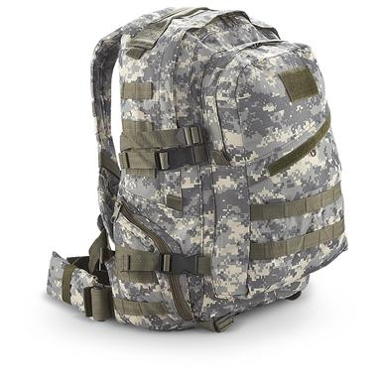
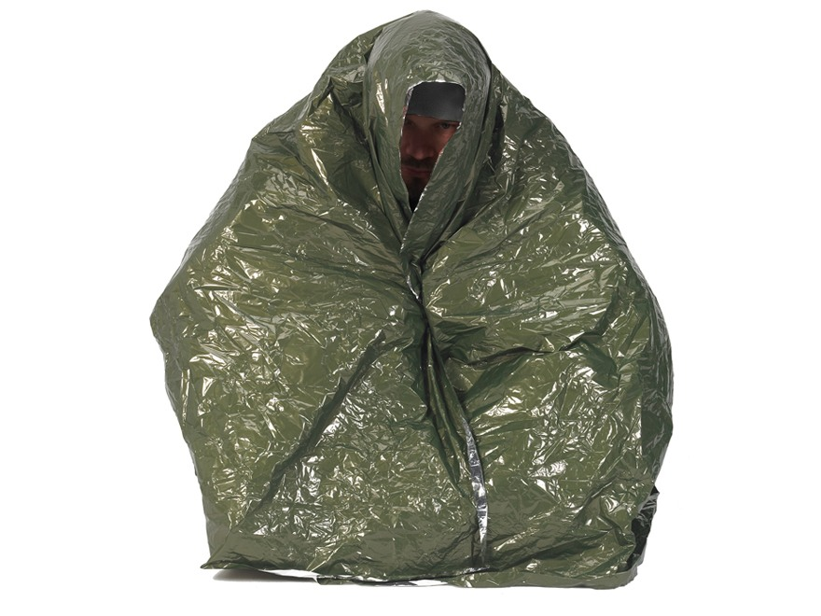
THE MIKE MIMS FOUNDATION INCORPORATED
DISASTER RELIEF AND HUMANITARIAN AID
Notes:
SV025 3-5 Days Survival Pack | MP267 Snugpak Combat Casuality Blanket

Slide 16
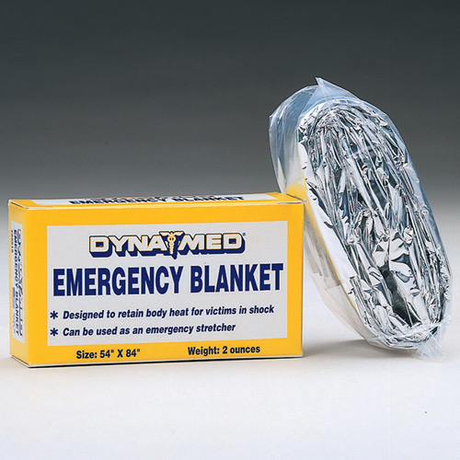

THE MIKE MIMS FOUNDATION INCORPORATED
DISASTER RELIEF AND HUMANITARIAN AID
Notes:
EB712 Dyna Med Emergency Space Blanket | EM042 Dyna Med Disposable Blanket

Slide 17
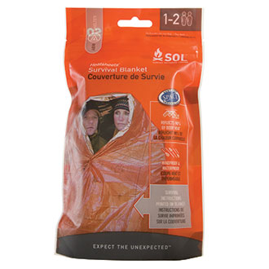
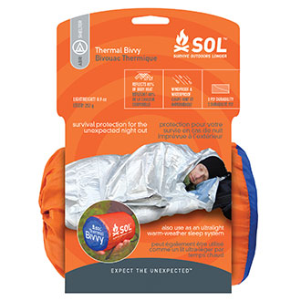
THE MIKE MIMS FOUNDATION INCORPORATED
‘
DISASTER RELIEF AND HUMANITARIAN AID
Notes:
EB015 Adventure Medical Survival Blanket | EB011 Adventure Medical Survival Sport Utility

Slide 18


THE MIKE MIMS FOUNDATION INCORPORATED
DISASTER RELEIF AND HUMANITARIAN AID
Notes:
EB004 Dyna Med Wool Blend Utility Blanket | EB003 Dyna Med Polyester Utility Blanket

Slide 19
THE MIKE MIMS FOUNDATION INCORPORATED
DISASTER RELIEF AND HUMANITARIAN AID
Global warming has artificially increased because of human impacts. With the overabundance rate of consumption, production and burning of fossil fuels etc. Additionally, the effects of these actions have lead to harmful consequences, which are irreversible. The effects of global warming are permanent and escalating; the following are immediate and fast developing threats:
- Floods
- Droughts
- Fires
- Diseases
- Stronger Storms
- Tsunamis
- Hurricanes
Tornadoes
Notes:
Global Warming

Slide 20
THE MIKE MIMS FOUNDATION INCORPORATED
DISASTER RELEIF AND HUMANITARIAN AID
As harsher weather conditions has increased storm frequency and severity so, it is inevitable that when we also factor in earthquakes and man made occurrences such as oil spills or even power outages that even the best laid disaster preparedness plan has to have a contingency.
“World News reports that over 90% of US households don’t have emergency or disaster preparedness kits assembled”. But for even for the best prepared household that has an emergency kit assembled if the home is damaged or destroyed in a storm and the kits is not accessible then that household will also require relief. Unfortunately municipalities, governmental agencies, insurance companies and human services organizations also have learned that stockpiled kits and most times are an underestimated so inventories are not sufficient to meet demand when an entire community needs the basic essentials to stabilize its immediate situation.
Notes:
Be Prepared For All Climate Weather Changes

Slide 21
THE MIKE MIMS FOUNDATION INCORPORATED
DISASTER RELIEF AND HUMANITARIAN AID
In Hurricane Katrina and more recently Hurricane Sandy the prevailing complaints posted by citizens and cataloged in the media were the following:
Speed of response
Lack of basic human essentials
Lack of provisions for people with disabilities
Vulnerability for the poorest citizen
Notes:
Stay The Course and Prepare

Slide 22
THE MIKE MIMS FOUNDATION INCORPORATED
DISASTER RELIEF AND HUMANITARIAN AID
As Americans when our neighbors and fellow citizens suffer from the devastating effects of a disaster we have always come together and collectively found a way to pull through, maintain and eventually heal. That is what makes this country great and that is a trait that will forever define us.
Notes:
BE ONE- Stay The Course

